Slide 1
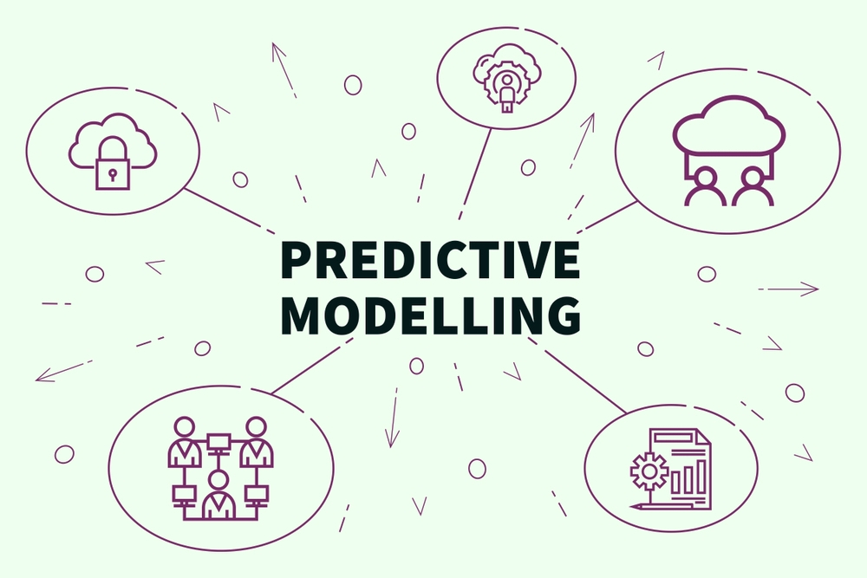


Slide 2


Slide 3
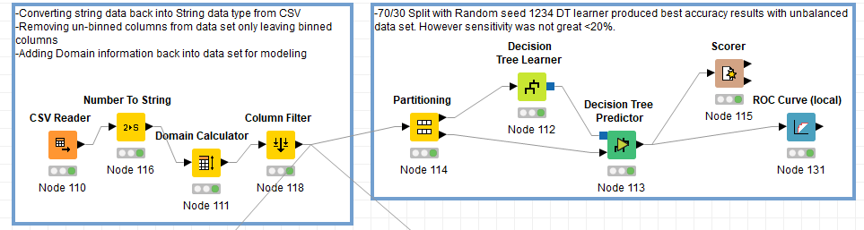
Decision Tree Model

Slide 4
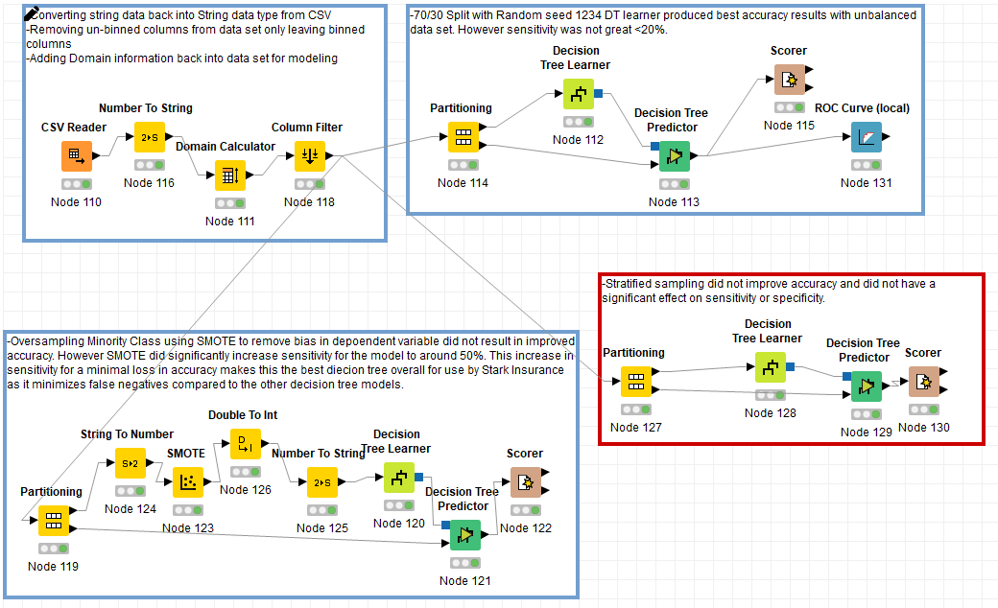
70/30 Split
70/30 Stratified
70/30 SMOTE
70/30
Accuracy ~83%
Sensitivity ~19%
Specificity ~98%
SMOTE
Improved Sensitivity
Accuracy only ~76%

Slide 5
Decision Tree Model
Quality Measure: Gain Ratio
Pruning Methods: MDL and Reduced Error Pruning
Min # Records Per Node:20
Created Fully Formed Tree

Slide 6
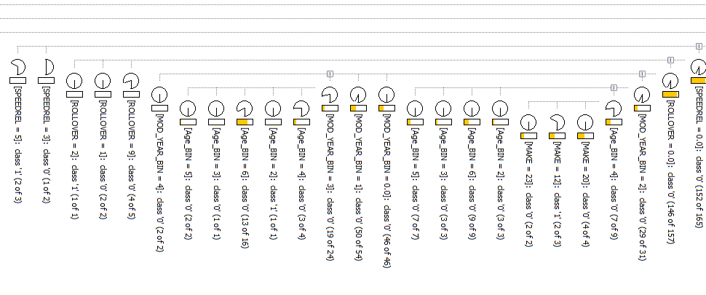
Un-optimized Decision Tree Model
AGE
MODEL
BODY_TYP
SPEEDREL
MAKE
REST_USE

Slide 7
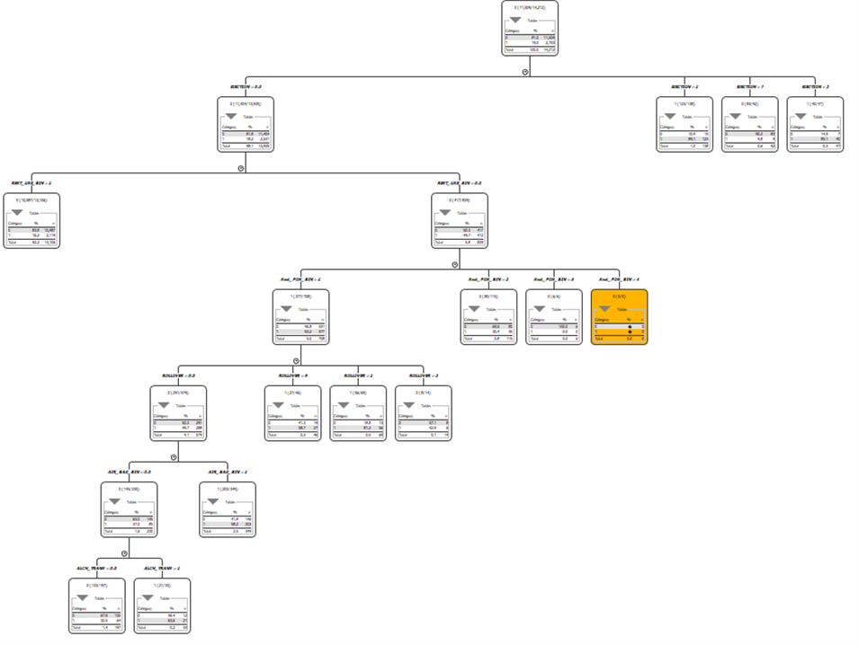

Slide 9
Random Forest Model
The goal of the random forest model (RF) is to average multiple decision trees to reduce the variance.
This model reduces the habit of overfitting the training data that decision trees are known for.

Slide 10
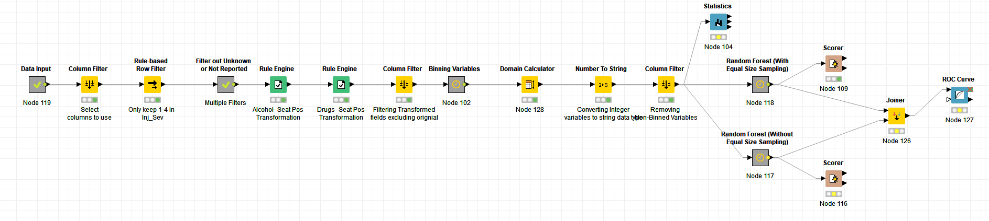
Random Forest Model

Slide 11
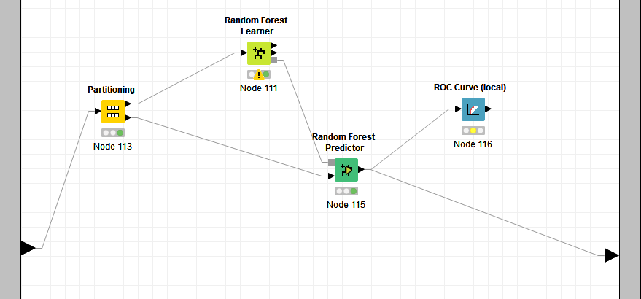
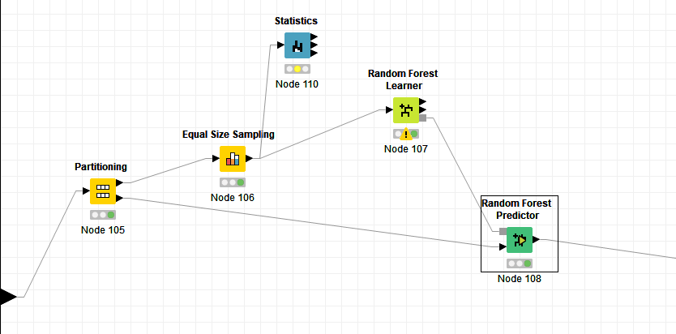
Random Forest Model

Slide 12
RF Model Settings
Minimum Node Size: 5
Split Criterion: Information Gain Ratio
Number of Models: 800
Random Seed: 12345

Slide 13
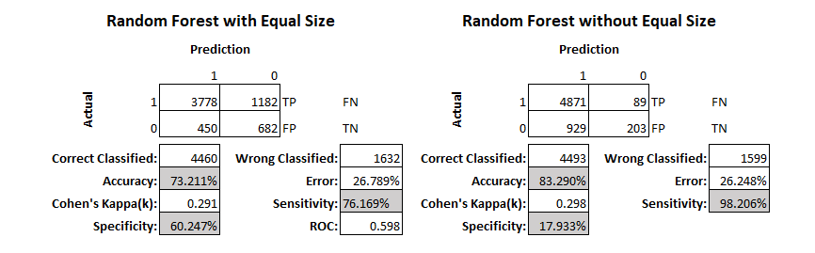
RF Model Results

Slide 14
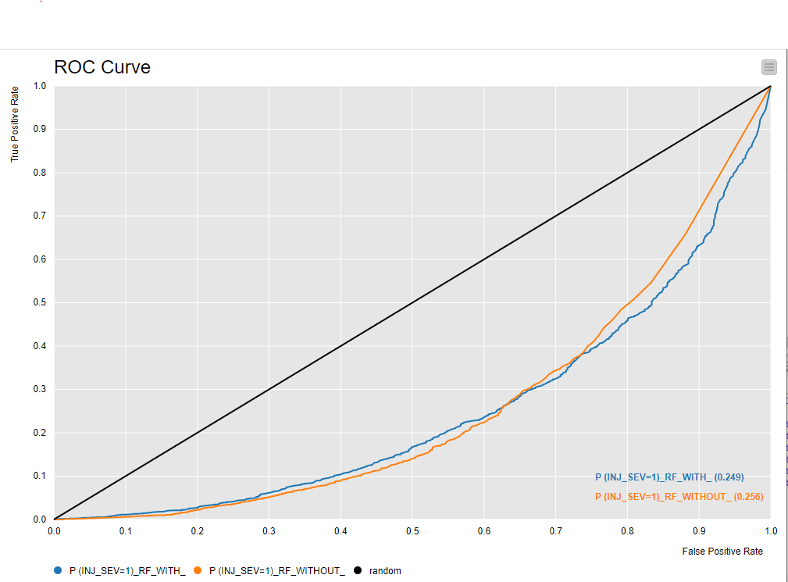
RF Model Results

Slide 15
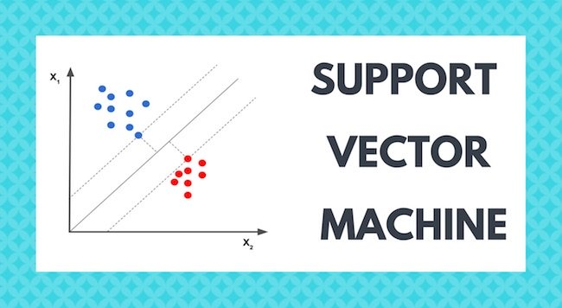

Slide 16
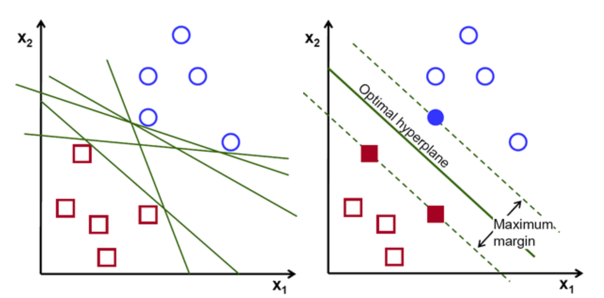
Support Vector Machine
A support vector machine (SVM) is a supervised learning model that has the objective to find a hyperplane in a n-dimensional space that distinctly classifies datapoints. SVM’s can be used to solve regression and classification problems.

Slide 17
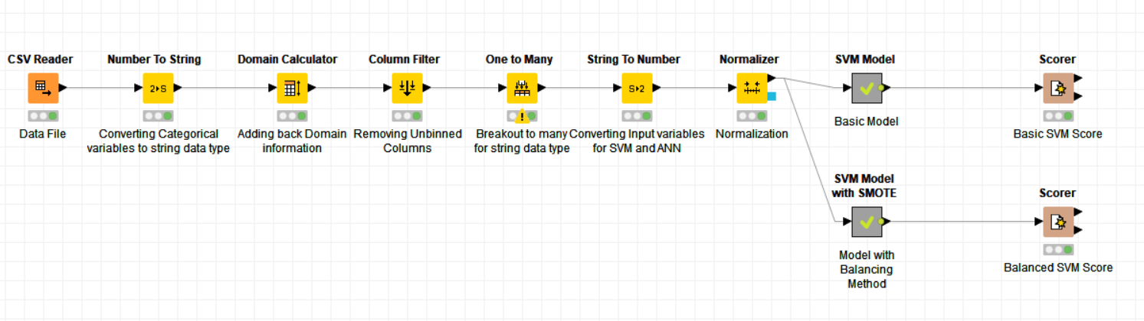
Support Vector Machine Workflow
Note the model uses the number loving data preparation steps which include one to many, string to number, and normalizer
Two models developed: 70/30 (training/validation), one applied the balancing method SMOTE and the other did not
SMOTE is a balancing method that will oversample the minority class of the dependent variable (which is 1)

Slide 18
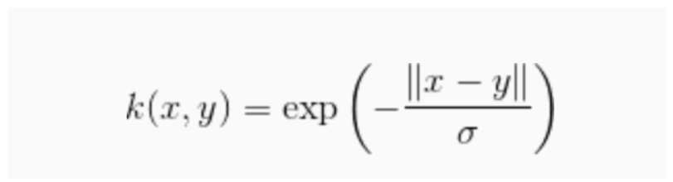
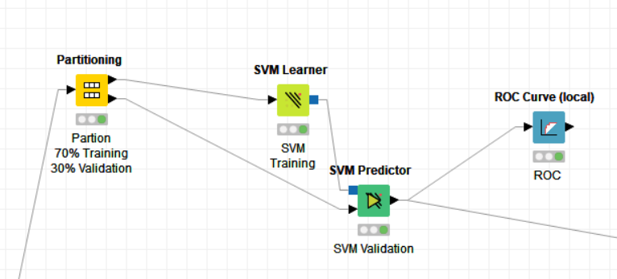
Basic Model
Model Inputs
Overlapping Penalty : 1.0 (applied when input data not separable)
Kernel: RBF (algorithm for pattern analysis)
Parameter (σ): 0.1
Random Seed: 12345

Slide 19
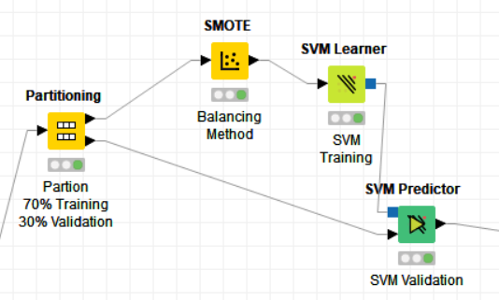
Basic Model w/ SMOTE
Model Inputs
Overlapping Penalty : 1.0 (applied when input data not separable)
Kernel: RBF (algorithm for pattern analysis)
Parameter (σ): 0.1
Random Seed: 12345

Slide 20
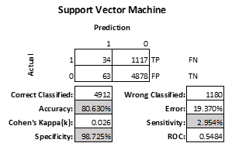
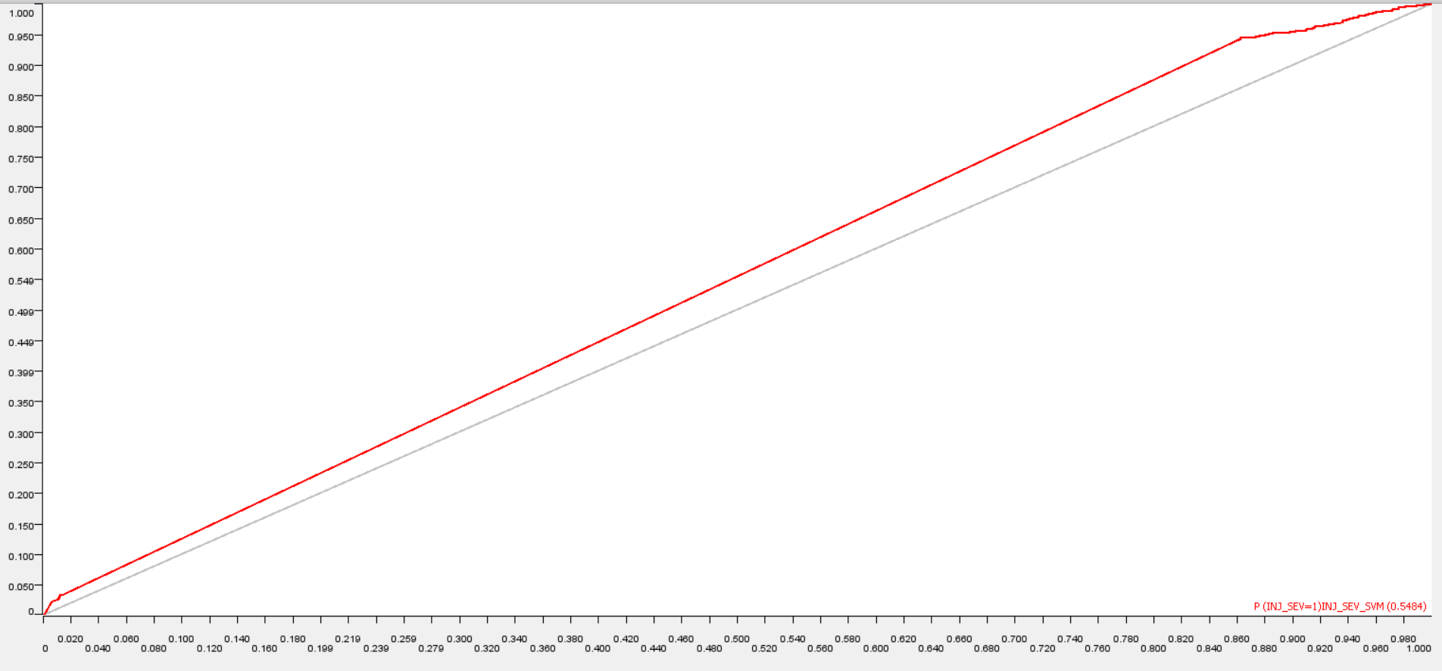
Model Results

Slide 21
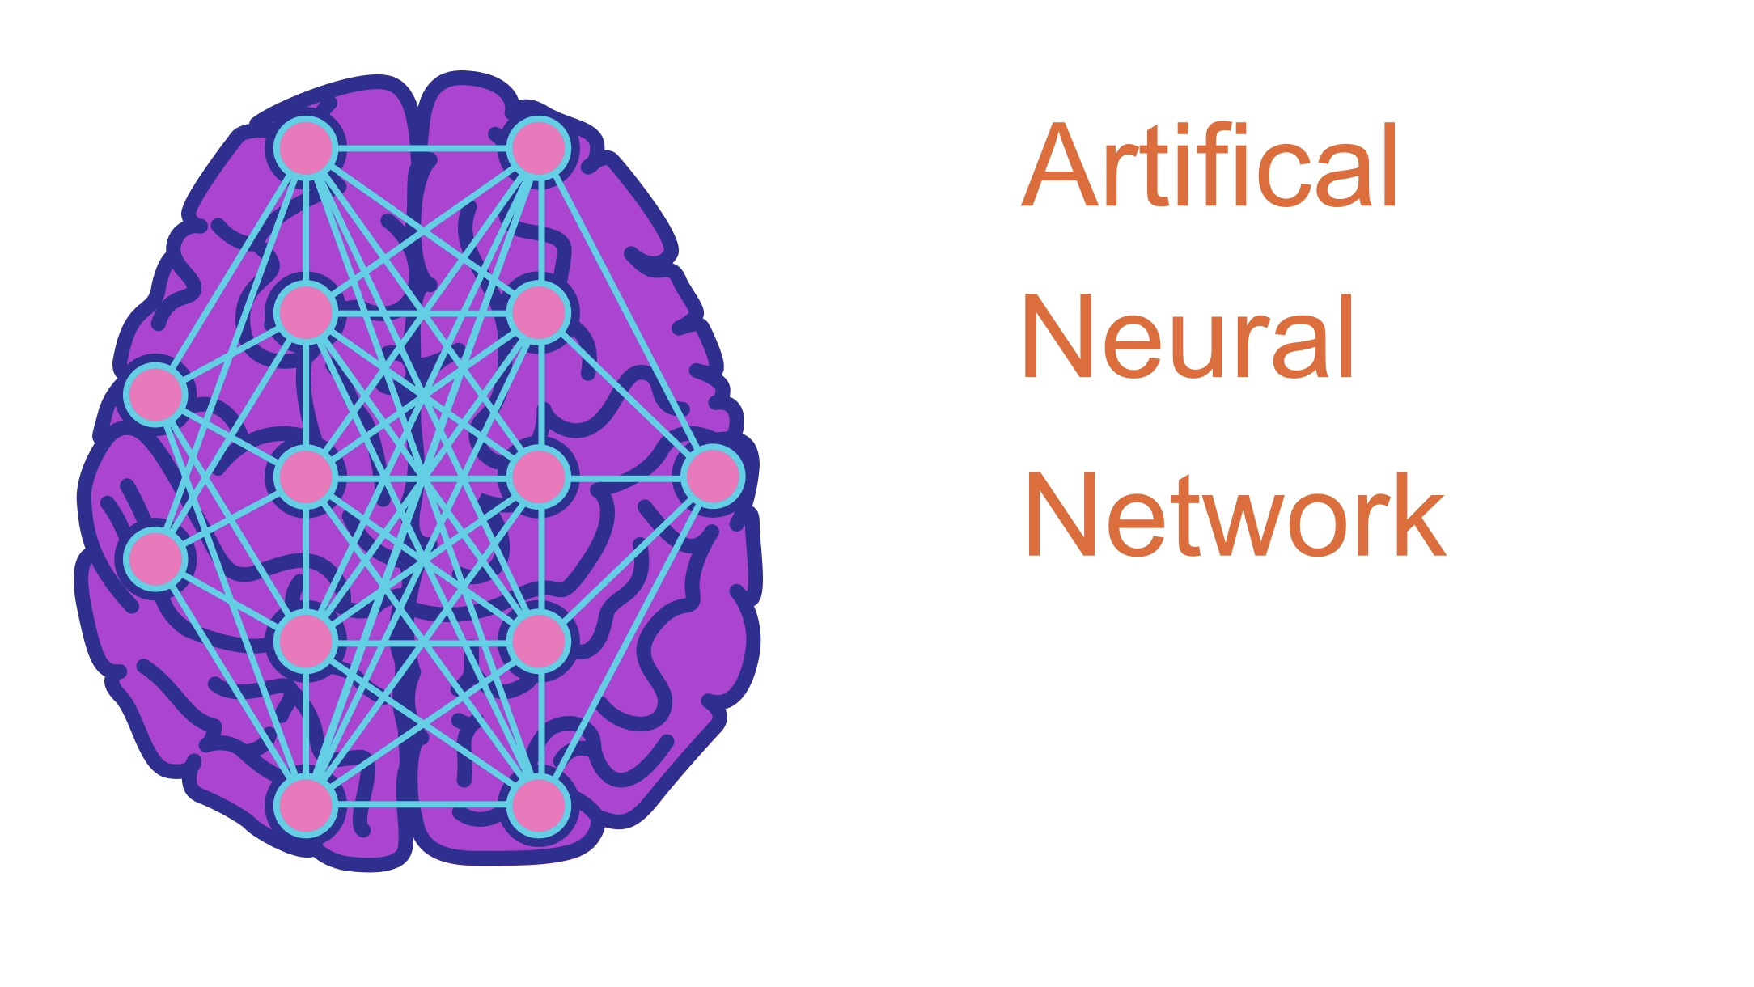

Slide 22
Artificial Neural Network (MLP)
Artificial Neural Networks (ANN) contain representations of biological entities such as synapses, axons, and dendrites. ANN contains at least one hidden layer of processor elements that perform the model’s work.
The RProp MLP (MultiLayer Perception) model was chosen due to being the best fit for tabular datasets and classification predictions problems.

Slide 23
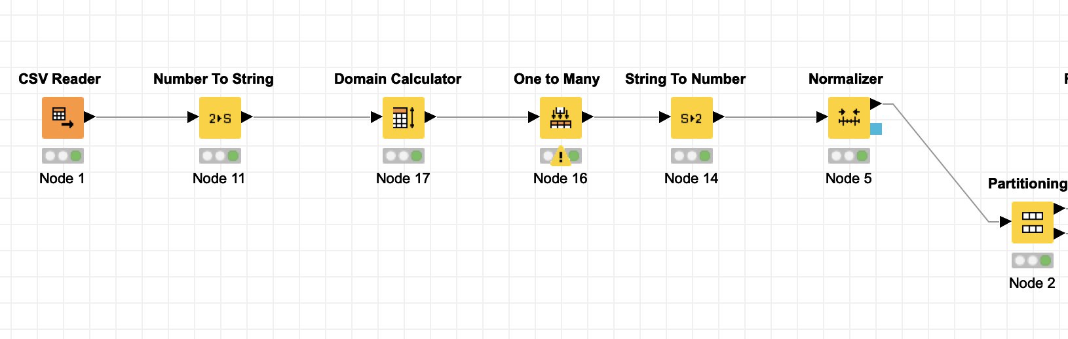
Artificial Neural Network (MLP)
Data Preparation
Conversion from number to string: In order to process One to Many
Domain Calculator: To prepare for Normalization
One to Many: Convert classifications to columns
String to Number: Prepare for Normalizer
Normalizer: Scale numerics to 0 to 1

Slide 24
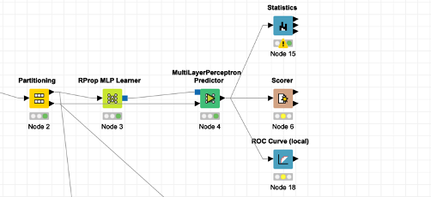
Artificial Neural Network (MLP)
Basic Model
For our Learner, we chose the following properties:
100 Maximum number of iterations
1 Hidden layer
10 Hidden neurons per layer

Slide 25
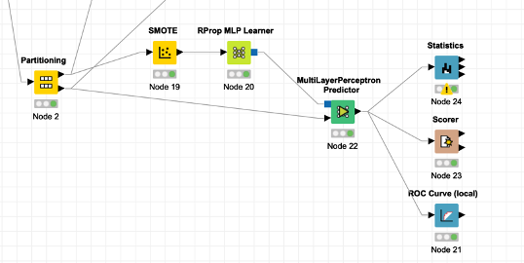
Artificial Neural Network (MLP)
Model with SMOTE
For our Learner, we chose the following properties:
100 Maximum number of iterations
1 Hidden layer
10 Hidden neurons per layer

Slide 26
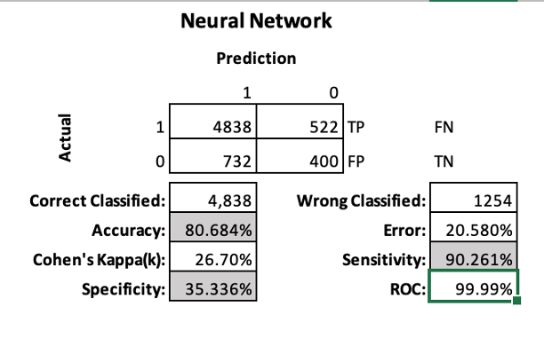
Artificial Neural Network (MLP)
Results

Slide 27

EVALUATION

Slide 28
Evaluation
Decision Tree
Accuracy: 83.569%
Sensitivity: 19%
Specificity: 98%
Random Forrest
Accuracy: 83.29%
Sensitivity: 98.26%
Specificity: 17.933%
Support Vector Machine
Accuracy: 80.63%
Sensitivity: 2.954%
Specificity: 98.725%
Artificial Neural Network
Accuracy: 80.68%
Sensitivity: 90.26%
Specificity: 35.33%
The winning model is Random Forrest
This model does produce a lot of false positives
For insurance purposes, overcharging versus undercharging others is a better outcome

Slide 29
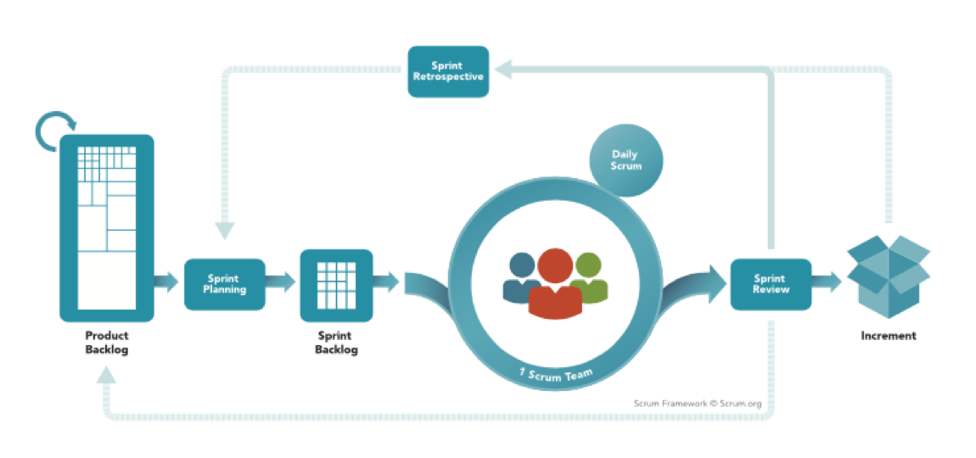


Deployment

Slide 30
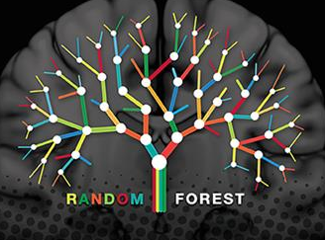



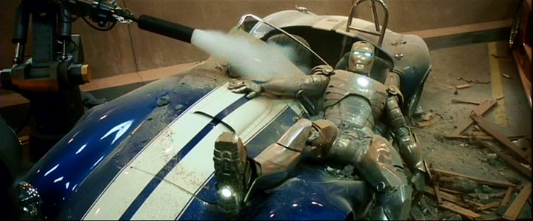

Deployment
Random Forest Model met evaluation criteria
Project will be handed over to Peter Parker and his team.
Integrate model into current Premium Pricing
Integrate model into current CRM system
Integrate model into “JARVIS” data warehouse
Happy and Pepper will bring the model back to their teams and perform additional analysis on the Random Forest model to see if it contains any further insights into:
Risk profiling vehicles/people
Improving Customer Service
PPS

